Slide 1


DEVELOPING A NETWORK DESIGN FOR RAILWAY TICKETING SYSTEM USING A CISCO PACKET TRACER

Slide 2

ABSTRACT
In today’s interconnected world, robust network systems are vital for large-scale operations like the railway industry's centralized ticketing system. This project designs and simulates such a network using Cisco Packet Tracer, focusing on seamless communication, real-time data exchange, and high availability.
The architecture follows a hierarchical model with Core, Distribution, and Access layers, incorporating redundancy to minimize downtime. VLANs are used to segment the network for enhanced performance and security, while Inter-VLAN routing ensures controlled communication. Advanced IP schemes, including subnetting, DHCP, and OSPF routing, optimize resource allocation and data flow. Security measures like ACLs and port security safeguard sensitive data.
Simulation results validate the design's efficiency, security, and scalability, underscoring its critical role in ensuring uninterrupted railway operations.

Slide 3

OBJECTIVES
Railway Ticketing System Network Design:
1. Seamless Communication
Establish uninterrupted data exchange between stations, ticketing counters, and centralized servers.
2. High Availability and Redundancy
Implement redundancy mechanisms to minimize downtime and ensure continuous operation during hardware or network failures.
3. Network Segmentation
Use VLANs to segment the network into functional areas (e.g., ticketing counters, administrative offices) for improved performance and security.
4. Efficient IP Resource Allocation
Optimize IP addressing through subnetting and DHCP to manage the network efficiently.

Slide 4

METHODOLOGY
The Centralized Railway Ticketing Network is designed and implemented using a structured, multi-layered approach to provide secure, scalable, and efficient network connectivity across regional offices, ticket counters, and public interfaces.
Network Design: The network is divided into a three-layer architecture:
Core Layer: Hosts critical servers and core routers at the data center, enabling centralized management and routing.
Distribution Layer: Contains Layer 3 switches at regional offices, managing local routing and connecting to the core.
Access Layer: Deploys Layer 2 switches at ticket counters and kiosks, providing connectivity for end devices.

Slide 5
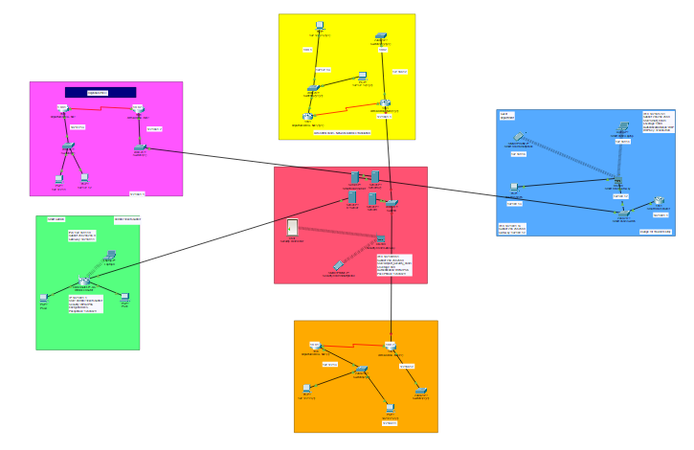
NETWORK DEVELOPED IN CISCO PACKET TRACER

Slide 6
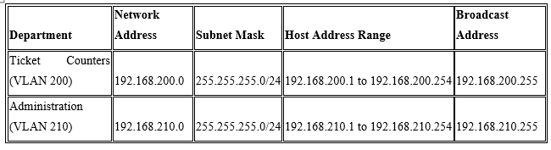
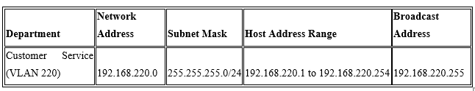
VLAN CONFIGURATION

Slide 7
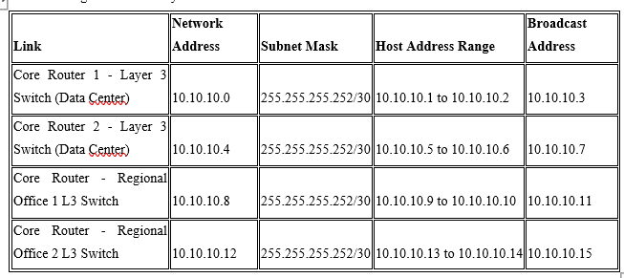
SUBNETTING

Slide 8
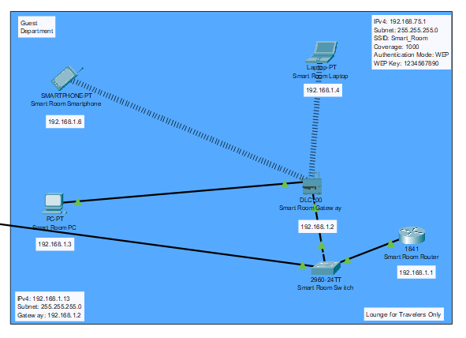
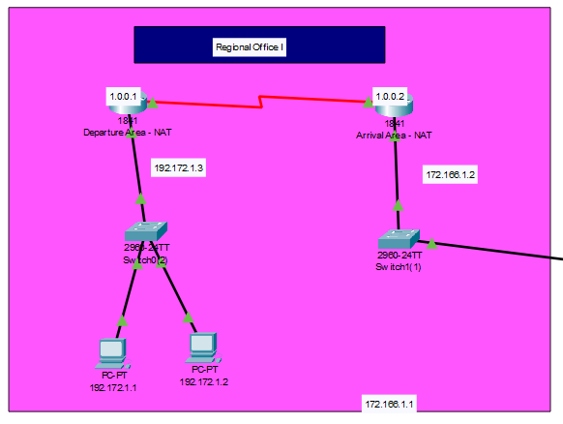

Slide 9
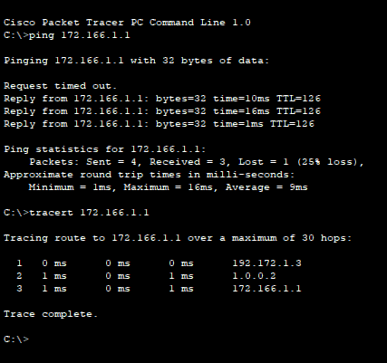

RESULT AND ANALYSIS

Slide 10
RESULT AND ANALYSIS
Results:
Centralized Management: Streamlines booking, payment, and data handling in one system, ensuring consistency and real-time updates.
System Efficiency: Faster bookings, reduced errors, and quicker updates due to centralized processing.
Security: Enhanced data integrity and security with standardized protocols for managing sensitive information.
Subnetting: Efficient subnetting ensures better network performance and segmentation, improving data flow and security across different network zones.
Web Security: Web security measures, like SSL/TLS encryption and secure payment gateways, protect user data and prevent cyber threats.

Slide 11
RESULT AND ANALYSIS
Analysis:
Scalability & Load Balancing: Efficient load balancing is crucial for handling high user traffic and maintaining performance during peak periods.
Reliability & Availability: Centralization improves reliability with real-time data and ensures minimal downtime through redundancy.
Cost Efficiency: Reduces operational costs by consolidating resources, though initial infrastructure investment is needed.
Security: Centralized storage allows for stronger security measures but requires backup and disaster recovery to avoid single-point failures.
VLAN: Virtual LANs (VLANs) help segregate traffic and improve network performance and security, ensuring sensitive data is isolated from general user traffic.

Slide 12
THANK YOU!
FOR YOUR ATTENTION
www.reallygreatsite.com

